Slide 1
3 address code(IR)
Discuss back-end compiler techniques such as language translation, code generation, scheduling and optimization.

Slide 2
Compiler construction is a difficult task. We need to have a good understanding of
formal language theory(REs, NFA, DFA,CFG e.t.c.)
Algorithms(greedy, heuristics techniques, dynamic programming, graphs, trees e.t.c.)
artificial intelligence ( used in code optimization mainly)
systems design
computer architecture(scheduling, pipelining, register allocation, synchronization e.t.c)

Slide 3
Translation order
To do this activity in an orderly structure,
most compilers are organized into three major phases:
analysis, (front end) Translation
an optimizer (middle end) Editing
Synthesis (back end) Proofreading

Slide 4
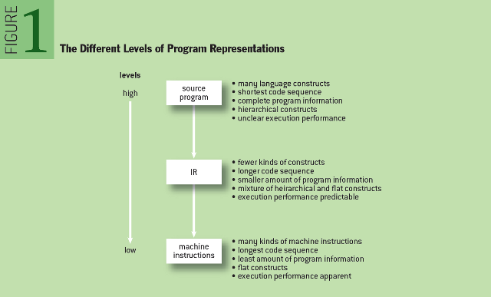
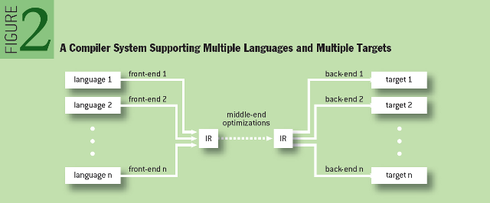
https://queue.acm.org/detail.cfm?id=2544374

Slide 5
Intermediate representation(IR)
The front end focuses on translating source code into some IR. Front ends rely on results from formal language theory and type theory, with a healthy dose of algorithms and data structures
The back end maps an IR program to the instruction set of a specific processor. A back end approximates the answers to hard problems in allocation and scheduling, and the quality of its approximation has a direct impact on the speed and size of the compiled code.
The middle end uses the IR to perform optimizations independent of the front end and back end. IR hides many machine-level details, but has instruction-level mapping to many assembly languages.

Slide 6
IR are also used between sub phases
Lexical analysis(tokens)
Syntax analysis(parse trees, Abstract parse trees)
Semantic analysis(annotated parse trees)

Slide 7
Intermediate representation(IR)
To divide the analysis and synthesis phases of language translation
To build retargetable compilers
We can build new back ends/front end for an existing front end,back end (make programming language more portable across various computer architectures,
We only have to write half-compilers instead of full compilers.( we can use the old half with a new half either language or architecture)
To perform machine independent optimizations.

Slide 8
What is IR
An intermediate representation is a representation of a program “between” the source and target languages. A good IR is one that is fairly independent of the source and target languages, so that it maximizes its ability to be used in a retargetable compiler.
The minimal requirement of an IR is to provide enough information for the correct execution of the original program. Each instruction in an IR typically represents one simple operation.
IR can be generated from (annotated) abstract parse trees of syntax (or semantic) analysis

Slide 9
Types of IR
hierarchical IR : Structured (graph or tree-based,)(high level)
A hierarchical IR is thus closer in form to the typical programming language, and is regarded as being at a higher level. A hierarchical IR can be represented internally in the form of trees (the data structure preferred by compilers) without loss of accuracy. These are heavily used in source-to-source translators and they tend to be large. DAGs are most common example.
Flat IR:
A flat IR is often viewed as the instructions of an abstract or virtual machine
tuple-based (low level)
The instructions are executed sequentially, as in a typical processor, and control flows are specified by branch or jump instructions. Each instruction takes a number of operands and produces a result. 3 address code is the most popular example of this form.
stack-based
In a stack-based IR, each operand for arithmetic computation is specified by an instruction that pushes the operand onto the stack. Each arithmetic expression evaluation is done on the operands that are popped off the top of the stack, and the subsequent result is pushed back onto the stack.
Hybrid any combination of the above popular is example is control flow graph

Slide 10
a=a+b+c;
=
a
+
a
+
b
c

Slide 11
a=a+b+c;
=
T1=b+c
T2=a+T1
a=T2
+
a
+
Postfix: a=ab+c+
Prefix: =a+a+bc
b
c
DAG
3 address code
hierarchical
Flat

Slide 12
Another example
while
while (a < b) {
a = b / 3;
}
<
{}
=
L0: If a<b goto L1
Goto L2
L1: T1=b/3
a=T/1
Goto L0
L2:
a
/
b
3
3 address code
DAG
Flat
hierarchical

Slide 13
3 address code
Use a maximum of three address to represent a statement
General form
a op b op c
a,b,c are operands which can be names or constants
Op represents operators
e.g.
a = b + c

Slide 14
Common forms
Assignments a = b + c
Assignment instructions a = + b
Copy a = b
Conditional jump if a < b goto c (where c is address of label)
Unconditional jump goto a
Parameter param a (store parameter a )
Procedural call call a , n (where a is the name and n is number of parameters)

Slide 15
How to generate three address code
a+b-c
a=b-c
a +b – c * d – e
Current operation | 3 address code
a +b – c | T1=a+b
a +b – c | T2 = a + b
Current operation | 3 address code
a =b – c | T1=b-c
a =b – c | a=T1
Current operation | 3 address code
a +b – c * d – e | T1=c * d
a +b – c * d – e | T2 = a + b
a +b – c * d – e | T3 = T2 – T1
a +b – c * d – e | T4 = T3 - e

Slide 16
How to generate three address code
-(a+b)-c
a = -(b – c) * d – e
Current operation | 3 address code
- (a +b) – c | T1=a+b
- (a +b) – c | T2= - T1
- (a +b) – c | T3 = T2-c
Current operation | 3 address code
a = - (b – c) * d – e | T1= b-c
a = - (b – c) * d – e | T2 = - T1
a = - (b – c) * d – e | T3 = T2 * d
a = - (b – c) * d – e | T4 = T3 – e
a = - (b – c) * d – e | a= T4

Slide 17
a+b-c
T1 =a+b
T2 =T1-c
a=b-c
T1=b-c
a=T1
a +b – c * d – e
T1=c*d
T2 = a + b
T3 = T2 – T1
T4 = T3 - e

Slide 18
-(a+b)-c
T1=a+b
T2= -T1
T3= T2-c
a = -(b – c) * d – e
T1= b-c
T2 = - T1
T3 = T2 * d
T4 = T3 – e
a= T4
More examples on
https://www.youtube.com/watch?v=zvf1sWcCtTg

Slide 19
If a < b then c =10 else c=20
If (a < b) goto true
goto false
true:
c = 10
goto end
false:
c=20
end:
exit

Slide 20
If a< b and c < d then e = 10 else e = 20
If (a < b) goto true1
goto false
true1:
If (c < d) goto true2
goto false
true2:
e = 10
goto end
false:
e=20
end:
exit

Slide 21
If a< b or c < d then e = 10 else e = 20
If (a < b) goto true1
goto false1
false1:
If (c < d) goto true
goto false2
true:
e = 10
goto end
false2:
e=20
end:
exit

Slide 22
Implementation of 3 address code
Three ways
Quadruples
Triples
Indirect Triples

Slide 23
quadruples
Use four fields in storage(we also use instruction number as address)
op, argument1, argument2, results
-(a+b)-c
T1=a+b
T2= -T1
T3= T2-c
Address/label | op | arg1 | arg2 | Result
1 | + | a | b | T1
2 | - | T1 |  | T2
3 | = | T2 | c | T3

Slide 24
a +b – c * d – e
Address/label | op | arg1 | arg2 | Result
1 | * | c | d | T1
2 | + | a | b | T2
3 | - | T2 | T1 | T3
4 | = | T3 | e | T4
T1=c*d
T2 = a + b
T3 = T2 – T1
T4 = T3 - e

Slide 25
a = -(b – c) * d – e
Address/label | op | arg1 | arg2 | Result
1 | - | b | C | T1
2 | - | T1 | b
3 | * | T2 | d | T3
4 | - | T3 | e | T4
5 | = | a | T4
T1= b-c
T2 = - T1
T3 = T2 * d
T4 = T3 – e
a= T4

Slide 26
If a < b then c =10 else c=20
If (a < b) goto true
goto false
true:
c = 10
goto end
false:
c=20
end:
exit
Address/label | op | arg1 | arg2 | Result
1 | < | a | b | T1
2 | goto | T1 |  | True
3 | goto |  |  | False
4/ True: | = | c | 10
5 | goto |  |  | End
6/ False | = | c | 20
7/End | Exit

Slide 27
If a< b or c < d then e = 10 else e = 20
If (a < b) goto true1
goto false1
false1:
If (c < d) goto true
goto false2
true:
e = 10
goto end
false2:
e=20
end:
exit
Address/label | op | arg1 | arg2 | Result
1 | < | a | b | T1
2 | goto | T1 |  | True
3 | goto |  |  | False1
4/False1 | < | c | d | T2
5 | goto | T2 |  | True
6 | goto |  |  | False2
7/ True | = | e | 10
8 | goto |  |  | End
9/ False2 | = | e | 20
10/End | Exit

Slide 28
Address/label | op | arg1 | arg2 | Result
1 | < | a | b | T1
2 | goto | T1 |  | True
3 | goto |  |  | False1
4/False1 | < | c | d | T2
5 | goto | T2 |  | True
6 | goto |  |  | False2
7/ True | = | e | 10
8 | goto |  |  | End
9/ False2 | = | e | 20
10/End | Exit
label | op | arg1 | arg2 | Result
 | < | a | b | T1
 | goto | T1 |  | True
 | goto |  |  | False1
False1 | < | c | d | T2
 | goto | T2 |  | True
 | goto |  |  | False2
True | = | e | 10
 | goto |  |  | End
False2 | = | e | 20
End | Exit

Slide 29
Quadruples
Advantage –
Easy to rearrange code for global optimization.
One can quickly access value of temporary variables using symbol table.
Disadvantage –
Contain lot of temporaries.
Temporary variable creation increases time and space complexity.

Slide 30
Triples
Use three fields in storage(we also use instruction number as address)
op, argument1, argument2
-(a+b)-c
T1=a+b
T2= -T1
T3= T2-c
Address/label | op | arg1 | arg2
1 | + | a | b
2 | - | (1)
3 | = | (2) | c

Slide 31
a +b – c * d – e
Address/label | op | arg1 | arg2
1 | * | c | d
2 | + | a | b
3 | - | (2) | (1)
4 | = | T3 | e
T1=c*d
T2 = a + b
T3 = T2 – T1
T4 = T3 - e

Slide 32
a = -(b – c) * d – e
Address/label | op | arg1 | arg2
1 | - | b | C
2 | - | (1) | b
3 | * | (2) | d
4 | - | (3) | e
5 | = | a | (4)
T1= b-c
T2 = - T1
T3 = T2 * d
T4 = T3 – e
a= T4

Slide 33
If a < b then c =10 else c=20
If (a < b) goto true
goto false
true:
c = 10
goto end
false:
c=20
end:
exit
Address/label | op | arg1 | arg2
1 | < | a | b
2 | goto | (1) | True
3 | goto |  | False
4/ True: | = | c | 10
5 | goto |  | End
6/ False | = | c | 20
7/End | Exit

Slide 34
If a< b or c < d then e = 10 else e = 20
If (a < b) goto true1
goto false1
false1:
If (c < d) goto true
goto false2
true:
e = 10
goto end
false2:
e=20
end:
exit
Address/label | op | arg1 | arg2
1 | < | a | b
2 | goto | (1) | True
3 | goto |  | False1
4/False1 | < | c | d
5 | goto | (4) | True
6 | goto |  | False2
7/ True | = | e | 10
8 | goto |  | End
9/ False2 | = | e | 20
10/End | Exit

Slide 35
Advantage
Take less space than quadruple representation
Disadvantage
Temporaries are implicit and difficult to rearrange code.
It is difficult to optimize because optimization involves moving intermediate code. When a triple is moved, any other triple referring to it must be updated also. With help of pointer one can directly access symbol table entry.

Slide 36
Indirect triples
We used temporary variables in quadruples so changing instruction order does not effect the results, but it will effect triples.
To over come this we use indirect triples, we use pointers to address instructions.
We can change the order but the point will always point to the same instruction

Slide 37
Indirect triples
 | Instruction
37 | 1
38 | 2
39 | 3
40 | 4
41 | 5
42 | 6
43 | 7
Address/label | op | arg1 | arg2
1 | < | a | b
2 | goto | (1) | True
3 | goto |  | False
4/ True: | = | c | 10
5 | goto |  | End
6/ False | = | c | 20
7/End | Exit

Slide 38
Please view
https://www.geeksforgeeks.org/three-address-code-compiler/
https://www.gatevidyalay.com/three-address-code/
https://www.tutorialspoint.com/compiler_design/compiler_design_intermediate_code_generations.htm
https://queue.acm.org/detail.cfm?id=2544374
cs.umd.edu/class/spring2014/cmsc430/lectures/lec11.pdf

